Slide 1





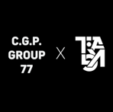
IOT FINAL PRESENTATION
IOT

Slide 2
Background
Maximum efficiency of a solar panel is 15% to 20%
Solar power is the least complicated and most reliable
Lowest environmental pollution
Aid in efficient decision making
Provide accurate and Up-to-date information

Slide 3
Problem and Solution
Problem
A panels maximum efficiency is between 15% to 20%.
Environmental factors reduces efficiency
No specific method to identify the cause of inefficiency
Solution
Optimize power output
A System to inform the user
Possible action to take

Slide 4
Objectives of Projects and Scope
Optimum power out of the used solar panel
Alert users of changes in efficiency
Affordable to anyone
Increase the usage and output of solar energy
Create a GUI

Slide 5
Current Systems
PV Module Monitoring based on low-cost solution: wireless raspberry application
IOT enabled solar power monitoring system – Dust-particle
Integrating A Cooling System For Solar PV Module To Maintain Energy Generation Efficiency
Battery
External Monitoring
Solar Panels
Inverter
Azure IOT Central
Panel Array Controller
Edge Controller

Slide 6
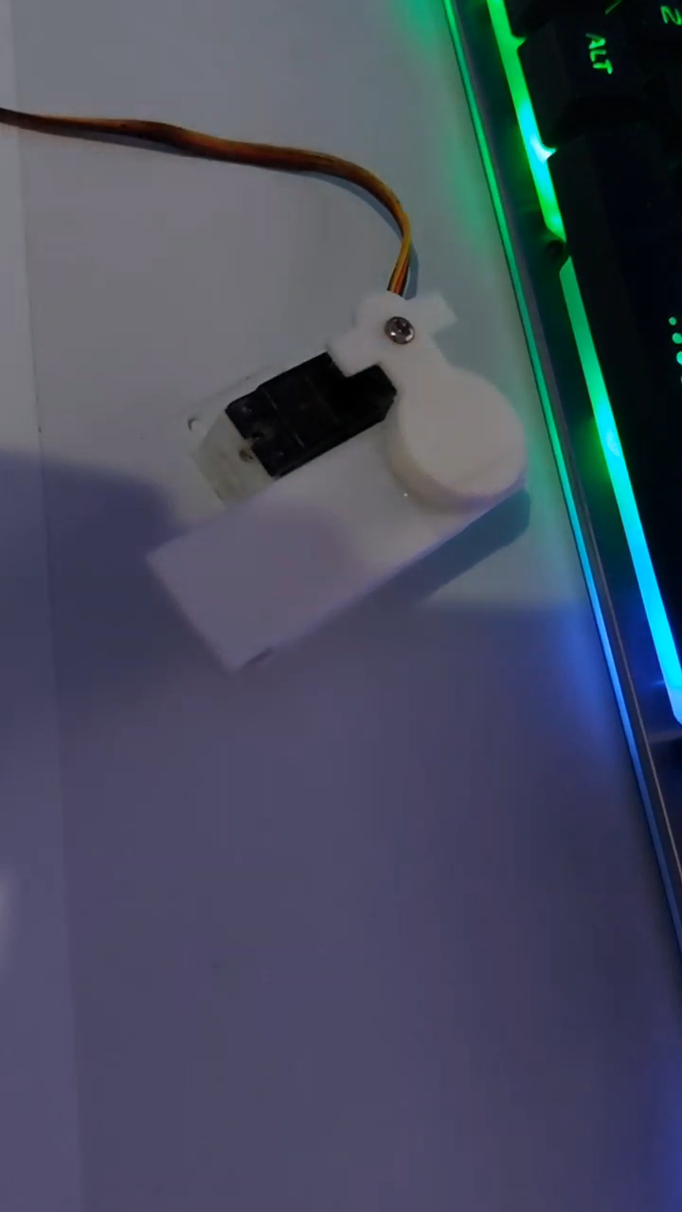
Applications
Dust Detection Unit / Dispense clean solution
Have two LDR Sensors in Place
One is covered by a Plastic Plate (Controlled Environment)
Motor can open and close the
cover when needed.

Slide 7
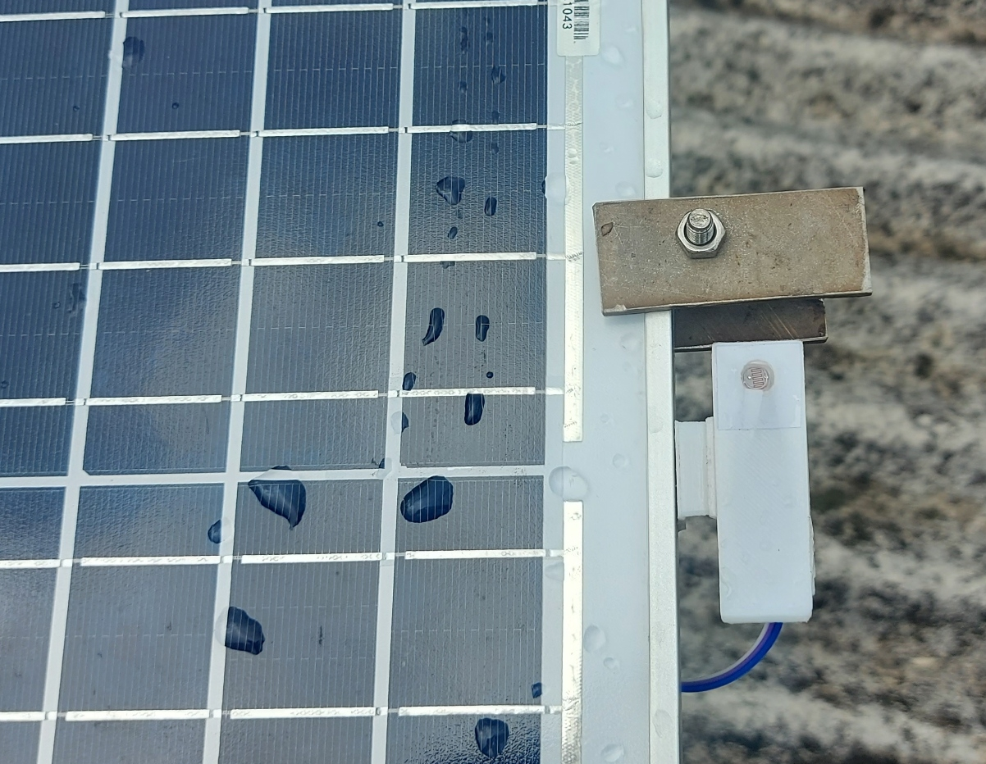
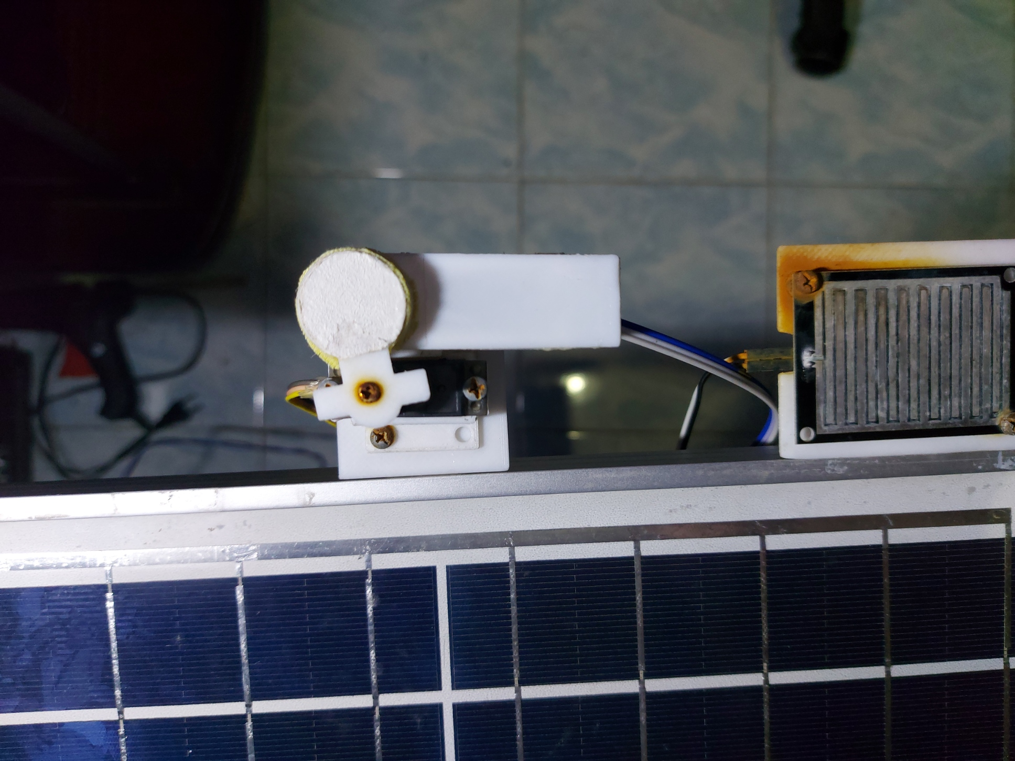
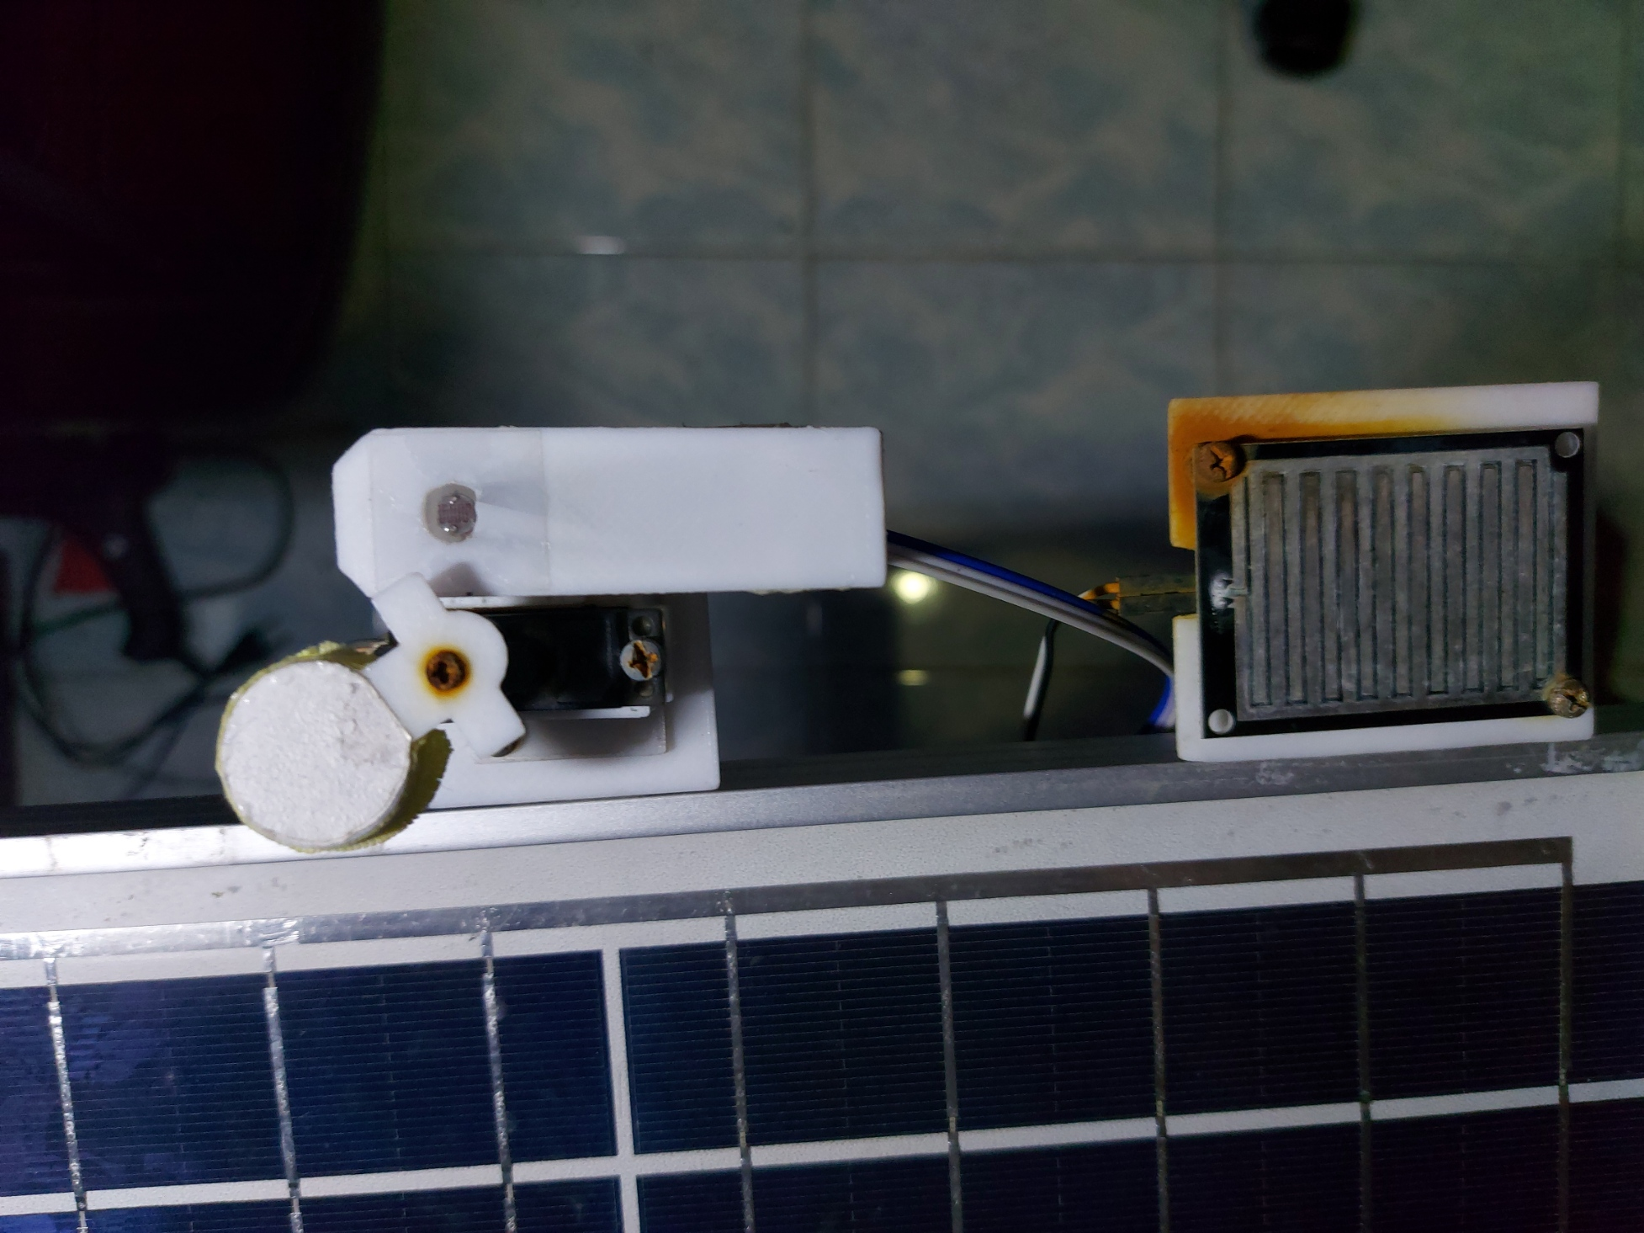
Applications
Dust Detection Unit / Dispense clean solution
Uncovered sensor will face the same environment faced by the panels (Dust, Light etc.)
Difference between the two sensors show the dust coverage on the panel.
Panel and Uncovered sensor can be cleaned at the same time.
Uncovered LDR Sensor
Covered LDR Sensor with Servo Motor (Dust Detection Unit)

Slide 8
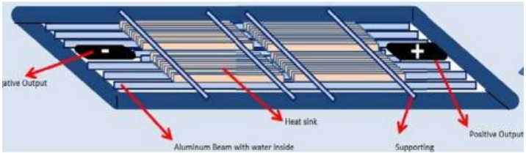
Applications
Temperature Controlling
Keeping the Panels (relatively) cool is the key to efficiency.
Incorporate Passive Cooling methods, monitor the temperature levels.
Using water cooling, diagram below;

Slide 9
Applications
Per Panel Statistics
Data that has been collected by an Individual panel.
Implementation of a dedicated monitoring system.
Makes troubleshoots easier for users.

Slide 10
Applications
Replacing Underperforming Panels
Replacement of parts is inevitable.
Using the system to identify the root of the problem.
Users can ask for assistance or replace parts accordingly.

Slide 11
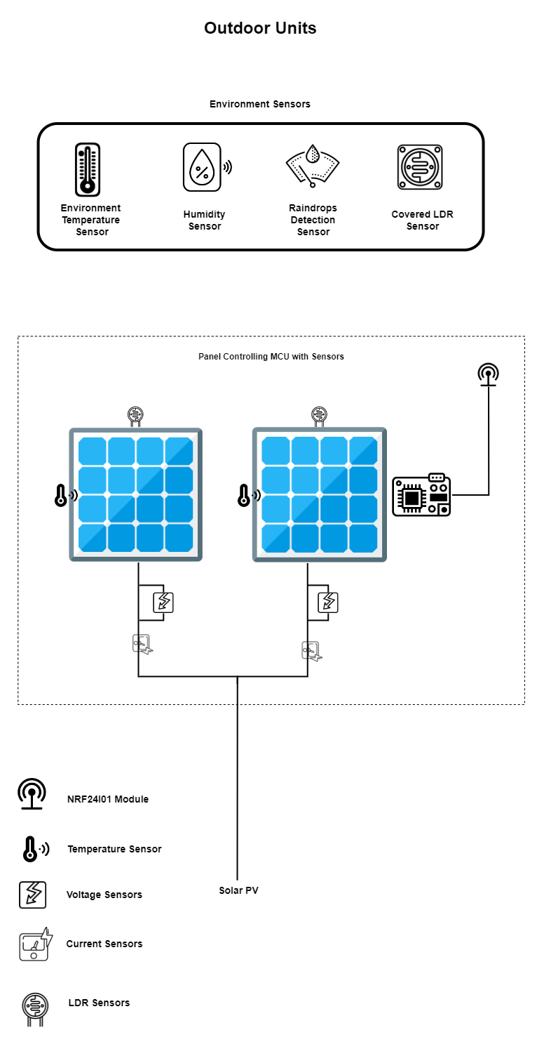
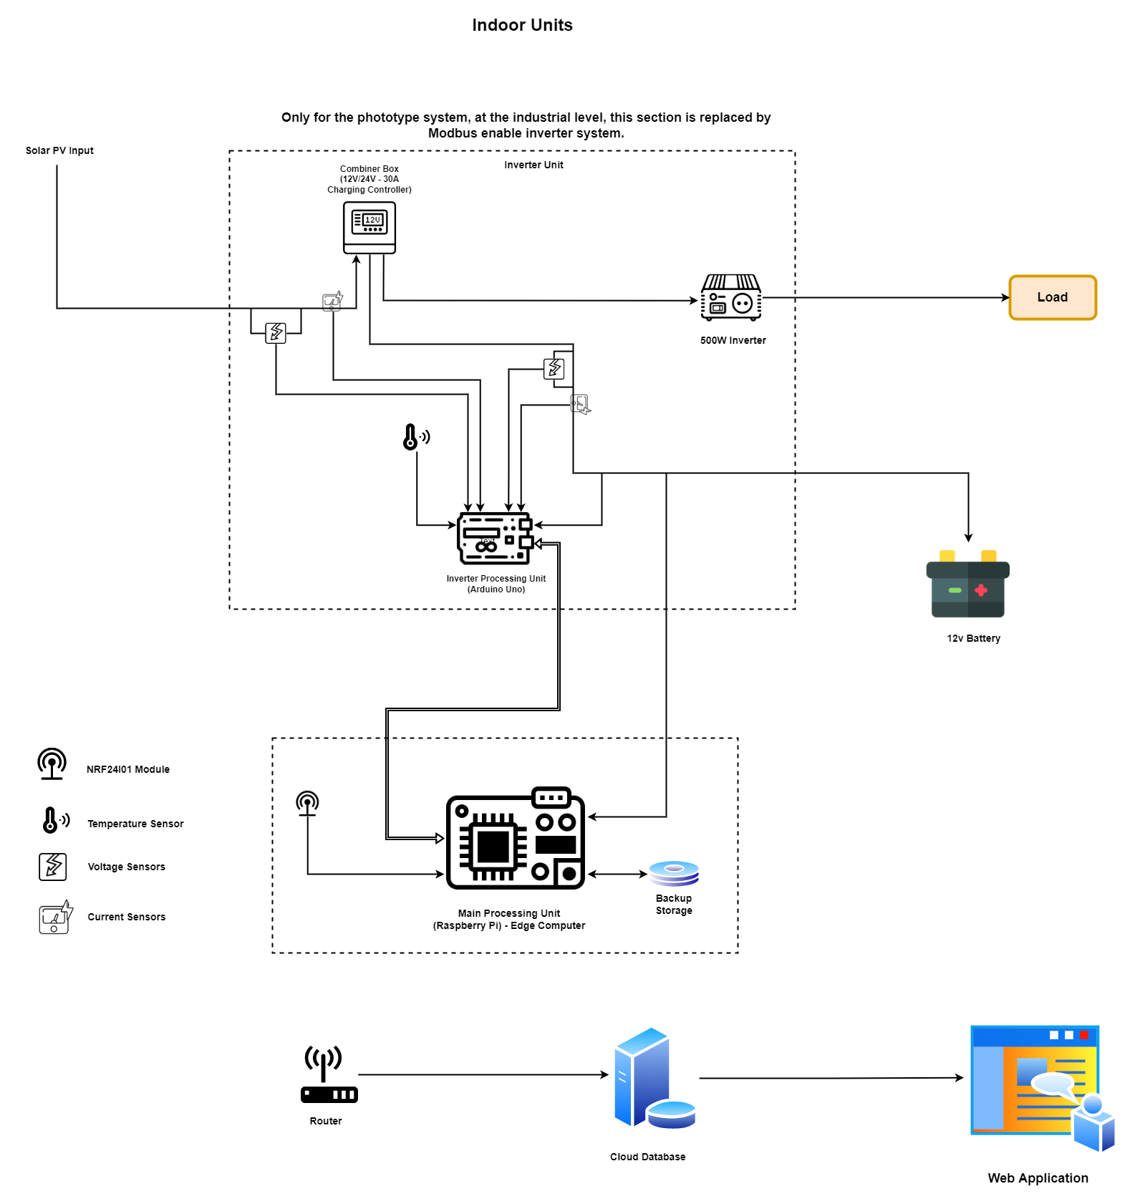
System Diagram
Power Consumption

Slide 12

System Diagram
IoT Architecture: Level 4
Local
Cloud
External Observer
Azure IOT Central
Location 1
Panel
Array
Edge Controller
Azure IOT Hub
MQTT
Location 2
Database
Panel
Array
Edge Controller

Slide 13
Hardware Components
Sensors
DS18B20 Sensor Module DS18B20 Sensor Module
Snow & Raindrops Detection Sensor Module
LDR Sensors
DHT11 Sensor Module (Temperature and Relative Humidity)
Voltage Detection Modules
ACS712 20A Current Sensor Modules
Inverter Unit
Arduino Uno
12V/24v 30A Auto Solar Panel Charge Controller
12V DC 500W Inverter
128×32 IIC I2C Blue OLED LCD Display Module
Other
Arduino Mega
microSD UHS-I 32GB Memory Card
LM2596 DC-DC Buck Converter Step-Down Power Modules
DS3231 RTC Module
Edge Computer
Raspberry Pi 4 Model B 4GB RAM 1.5GHz 64bit CPU
Actuator
Servo Motor Metal Wheel MG995
Communication
NRF24L01 2.4GHz Wireless Transceiver Modules

Slide 14
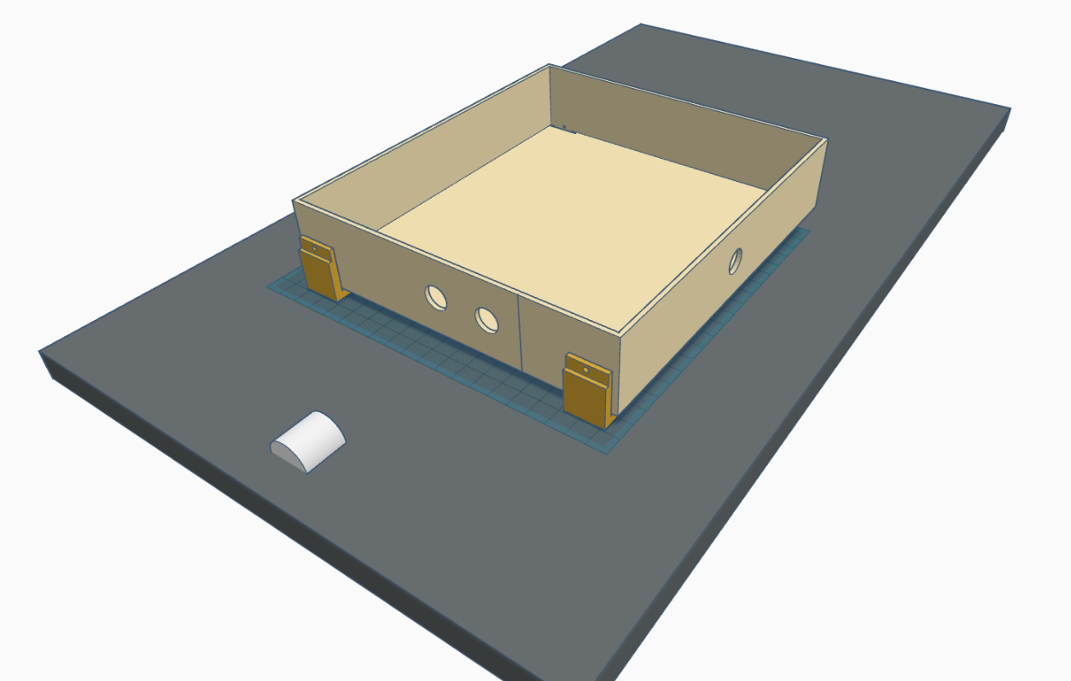
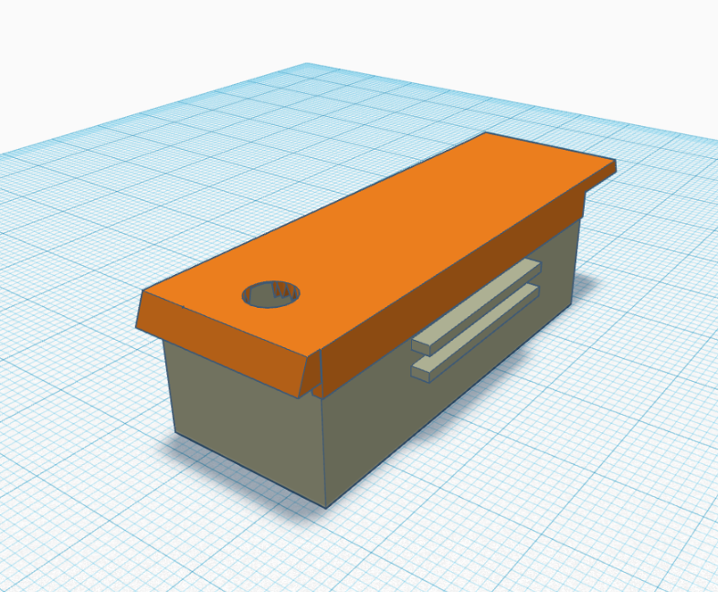
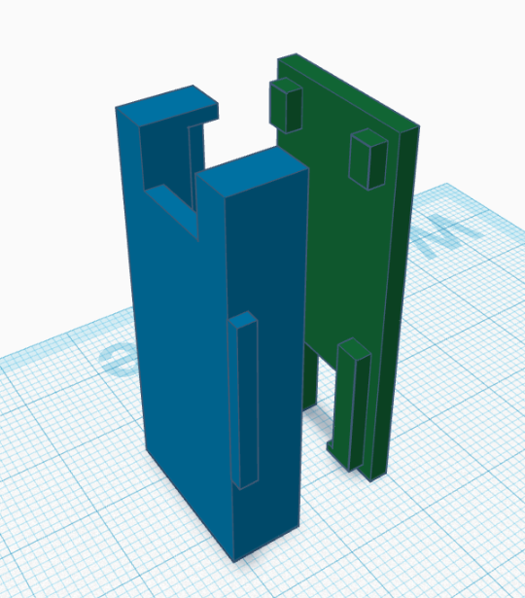
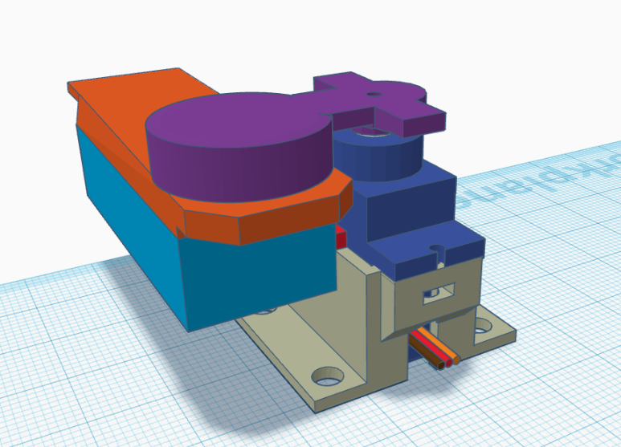
Hardware Components
3D Designs
Waterproof LDR Sensor Cover
NRF24L01 Module Cover
Solar Panel
Solar Panel Monitoring Unit Box
Dust Detection Unit

Slide 15
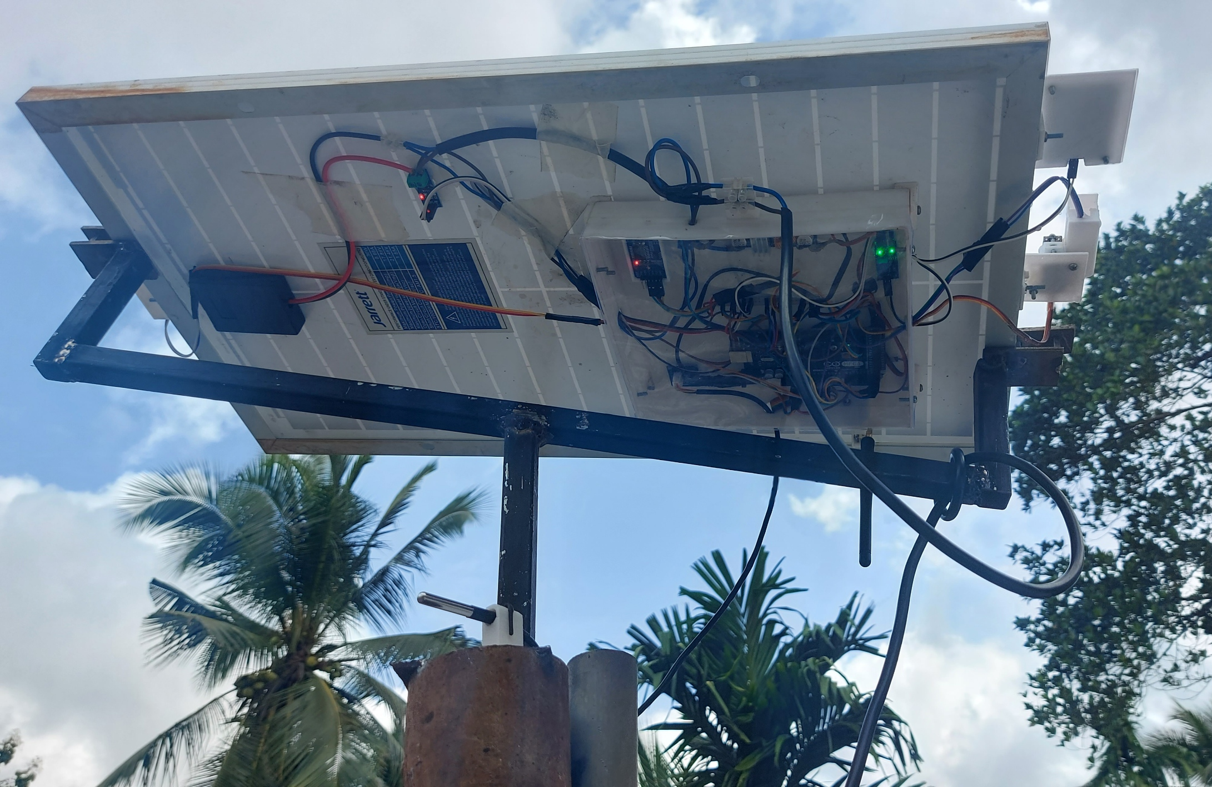
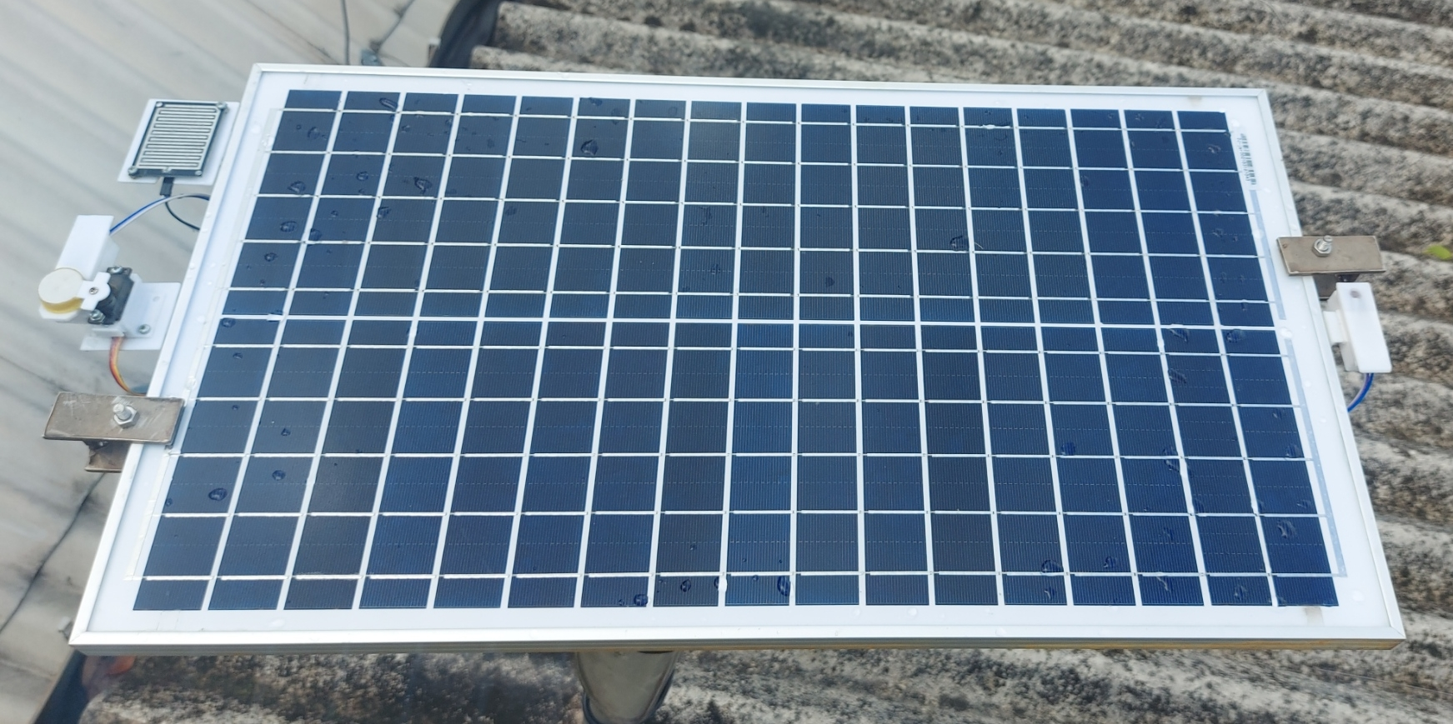
Working Product
Outdoor Unit

Slide 16
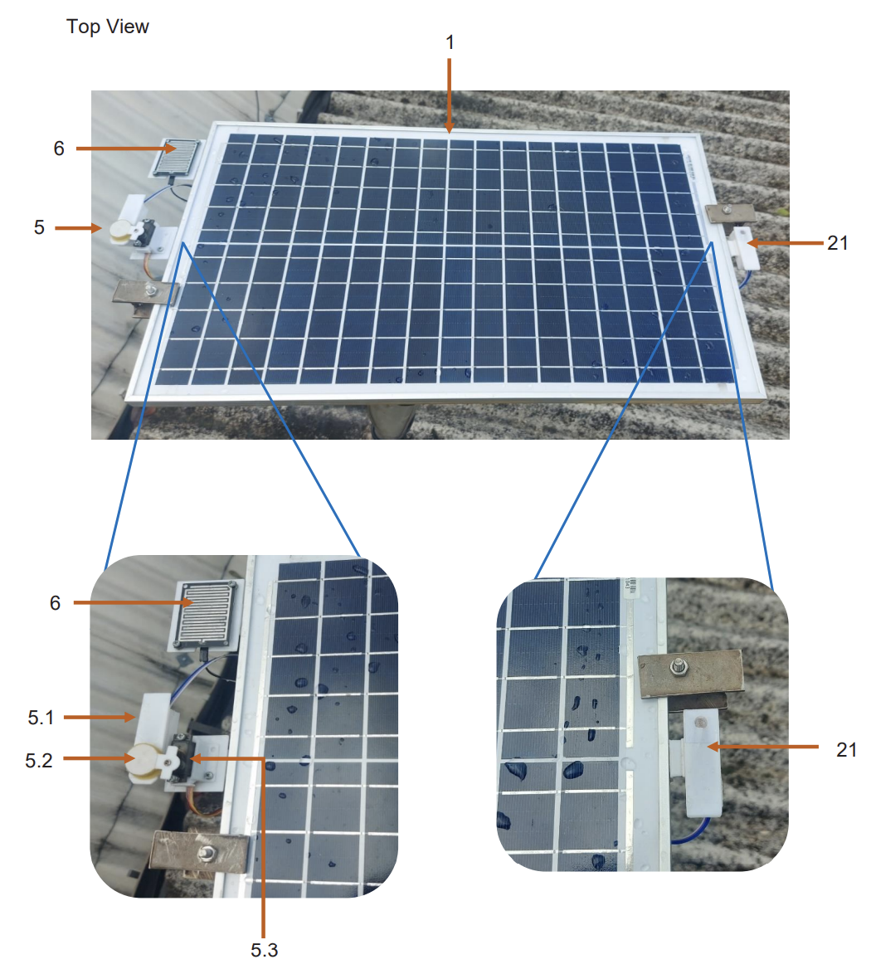
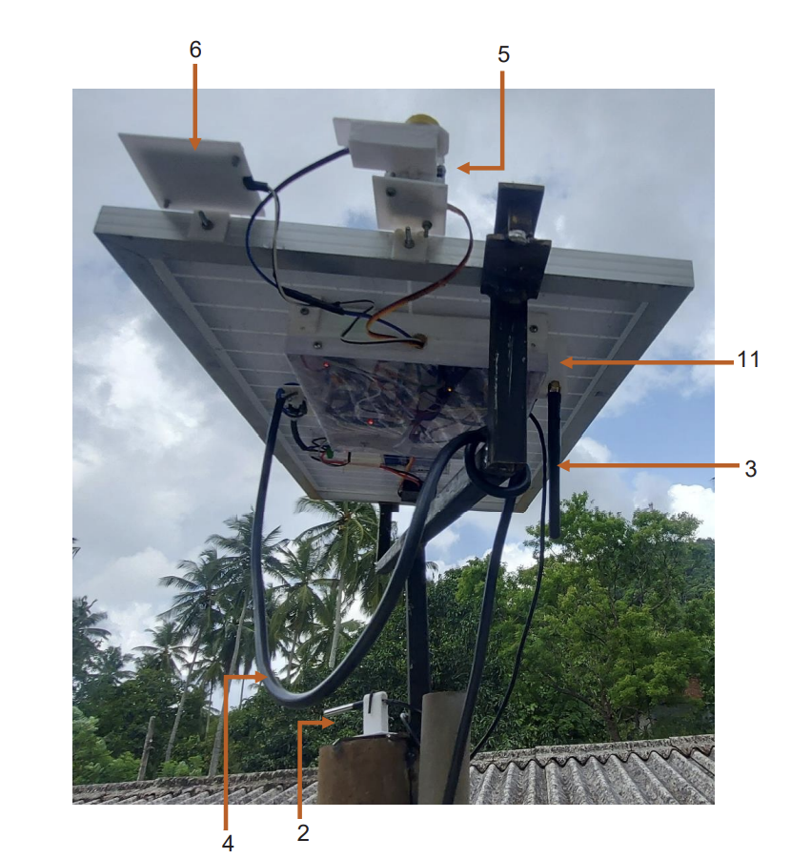
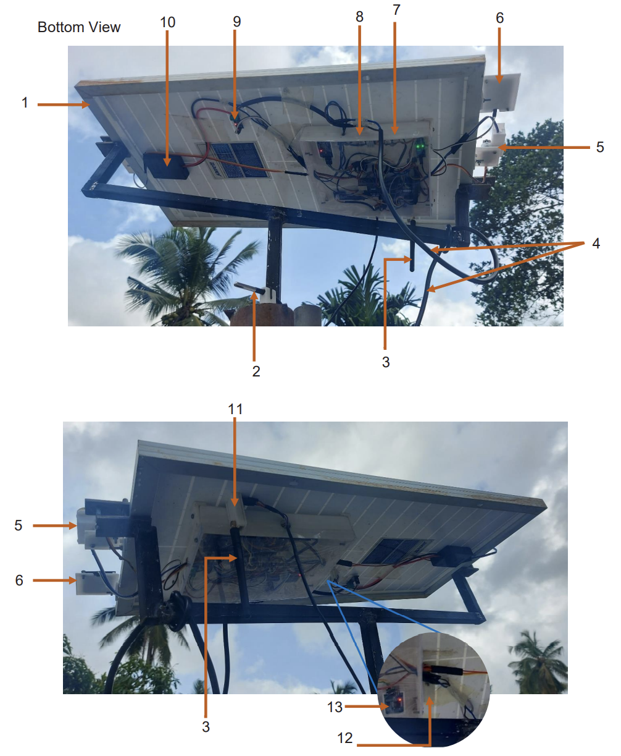
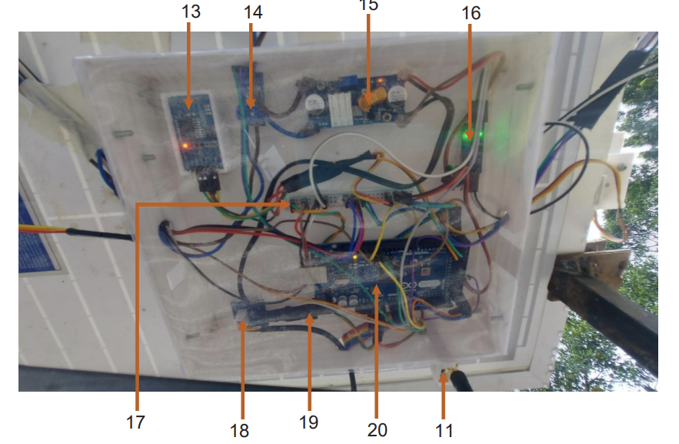
Working Product
Outdoor Unit

Slide 17
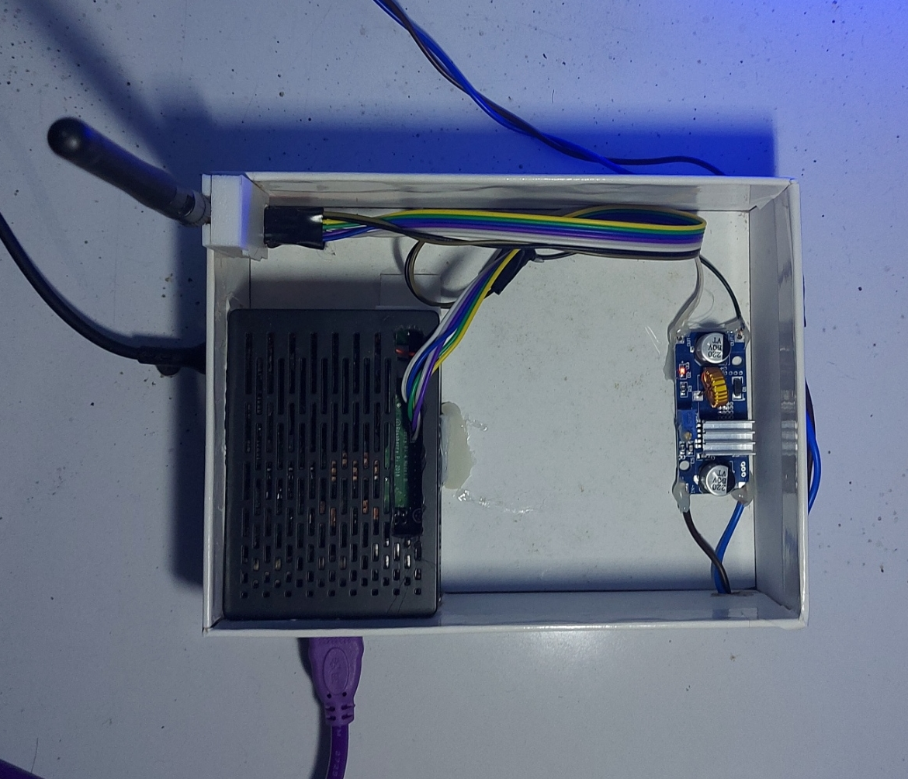
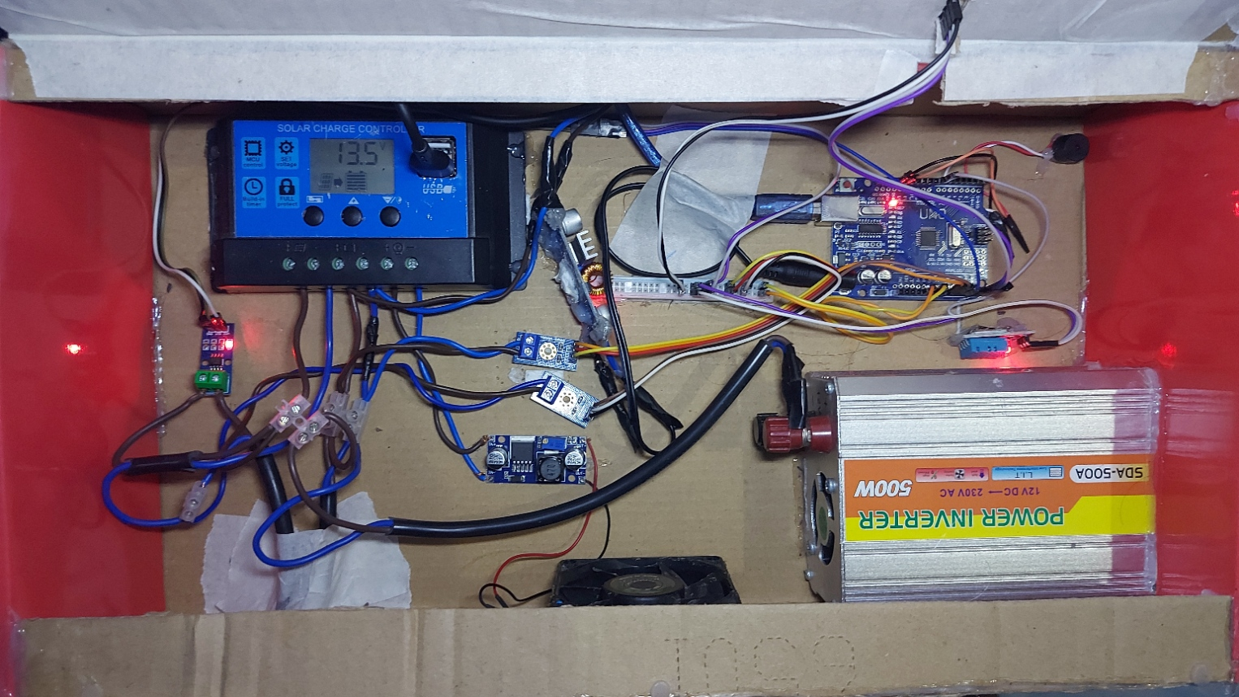
Working Product
Indoor Unit

Slide 18
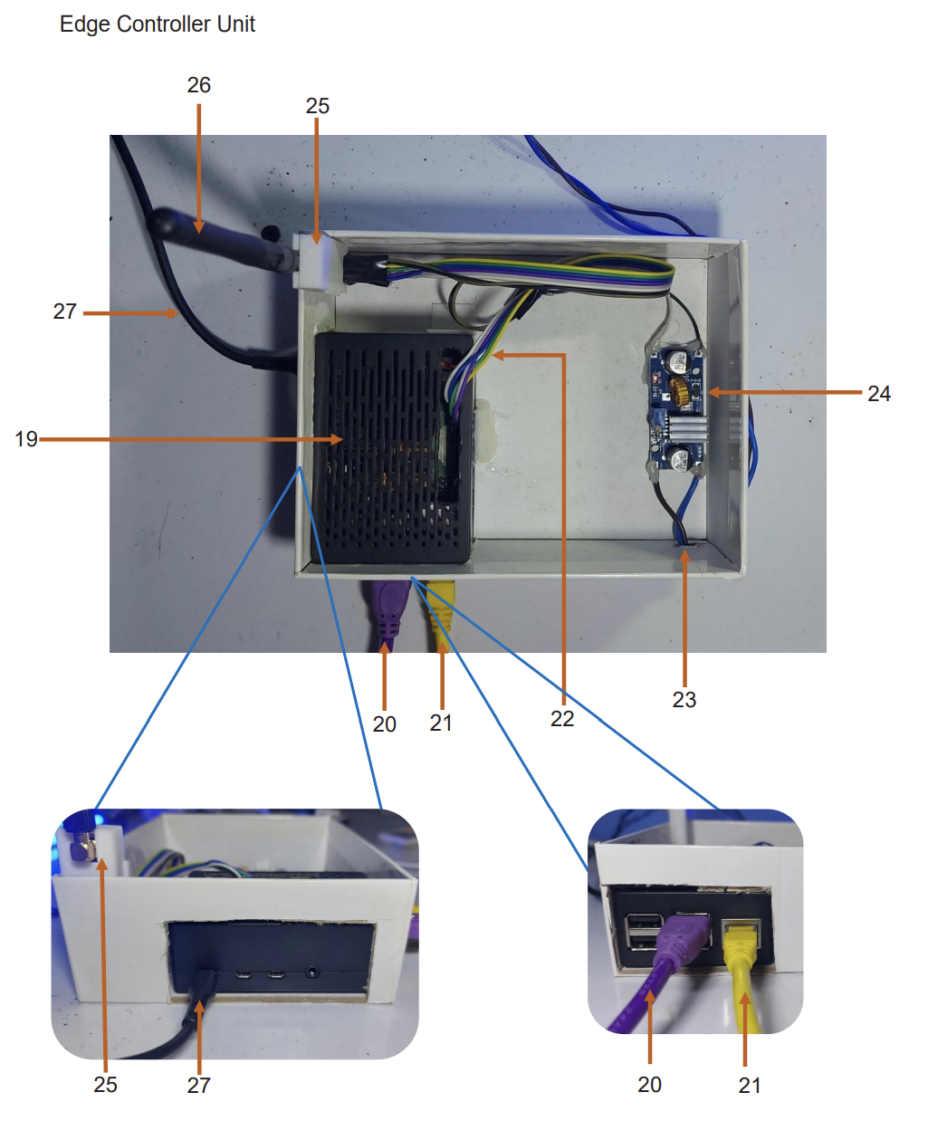
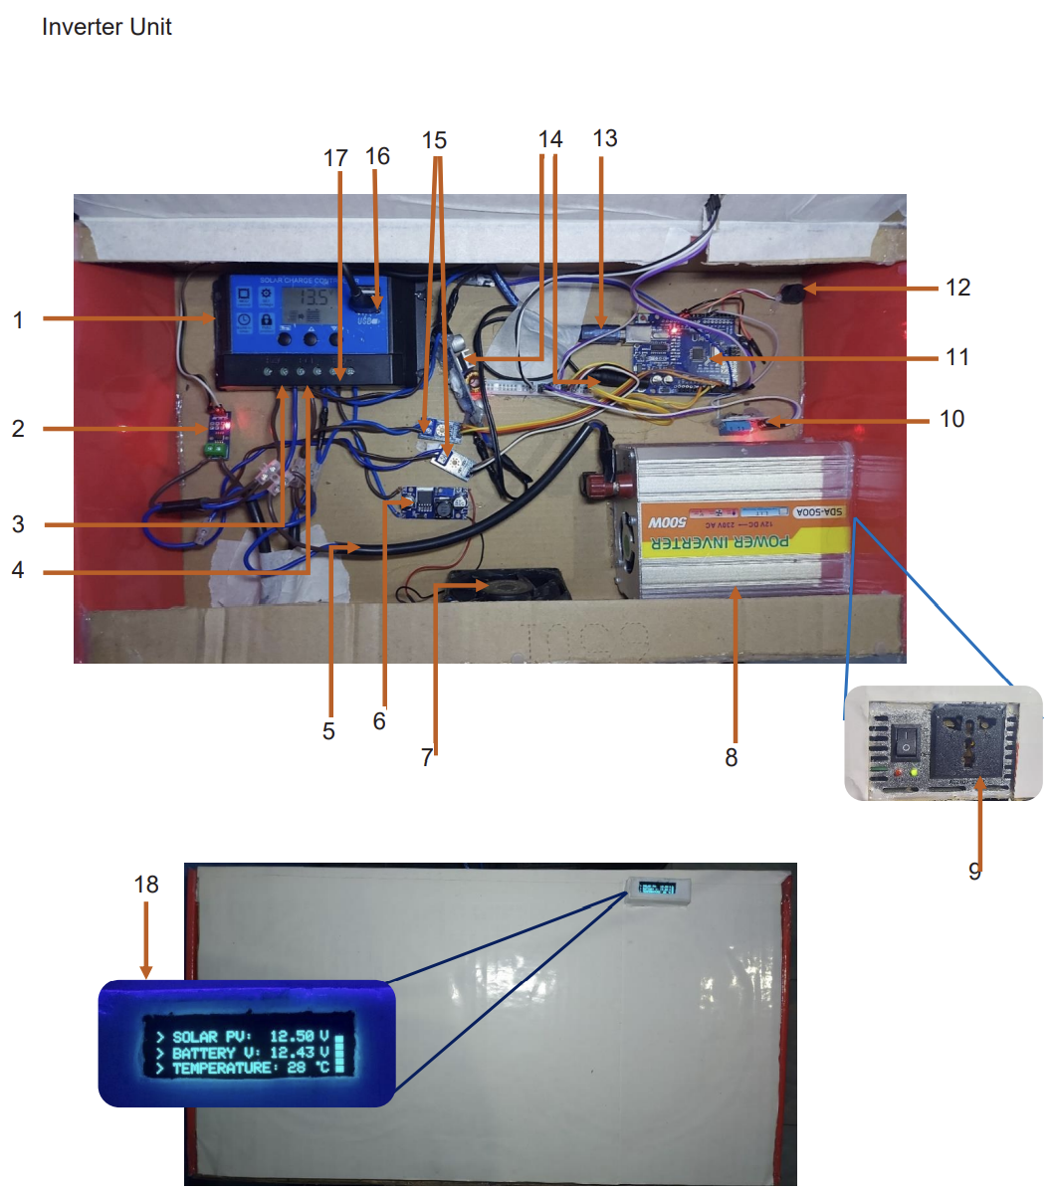
Working Product
Indoor Unit

Slide 19
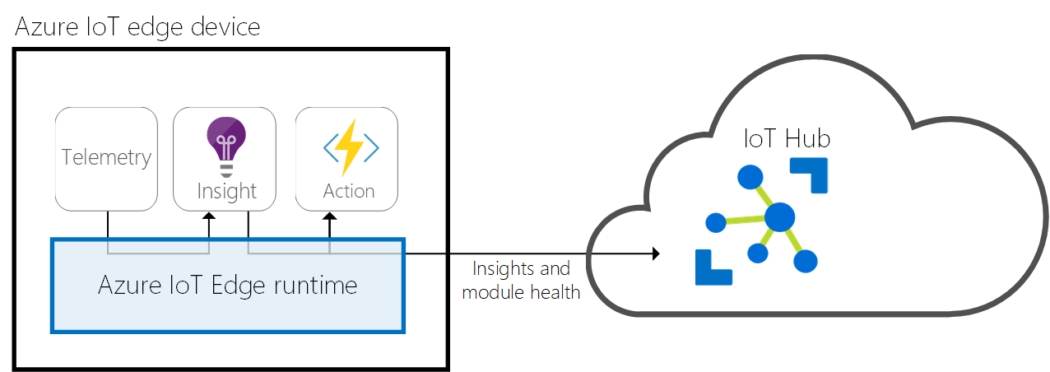

Software
Modbus
why/what
Arduino
why/what
Python
why/what
Inverter Stat
Software Update
Panel Array
Why use raspberry pi
Modbus Slave
Azure Functional Module
How ->
Azure IOT Runtime

Slide 20
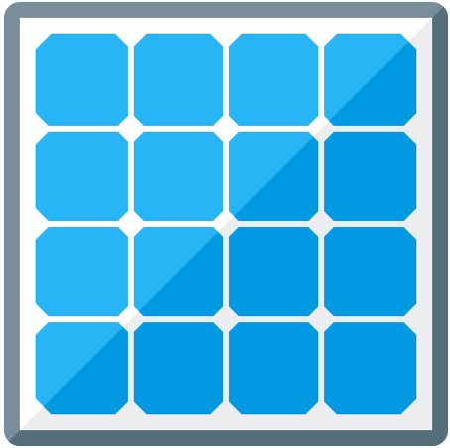
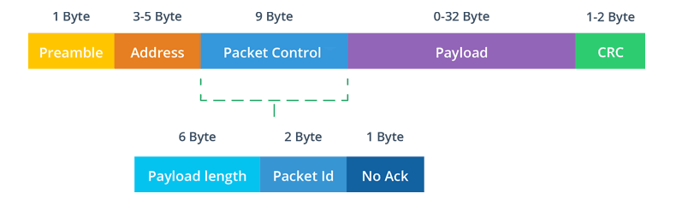
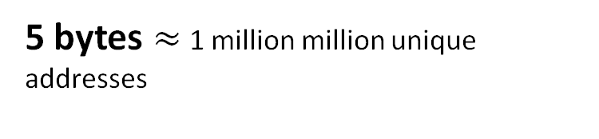
Network
Panel Controller to the Edge
Wireless communication
Why NRF24L01+ (Range, Bandwidth, Power)
Enhanced ShockBurst Protocol
Limitations & Solutions
Security
Edge
5 bytes $≈$ 1 million million unique addresses
https://lastminuteengineers.com/nrf24l01-arduino-wireless-communication/

Slide 21
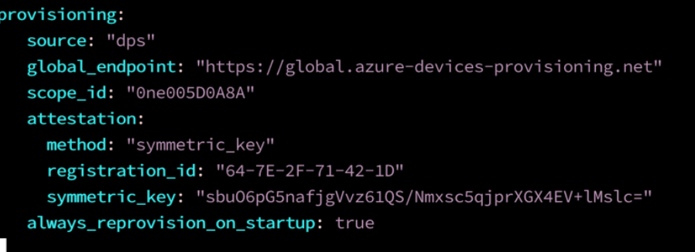
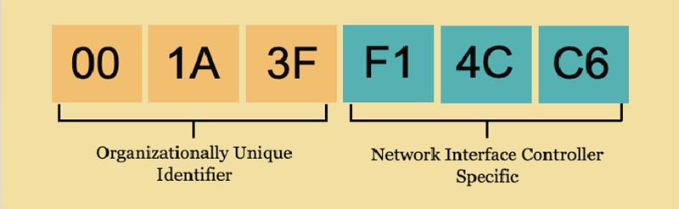
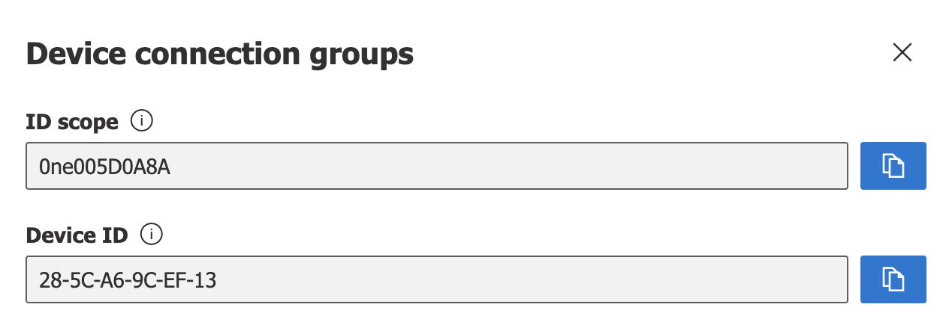
Network
Edge Controller to Cloud
Ethernet / WiFi
Azure IOT SDK (MQTT Protocol)
Symmetric key message encryption
Device Identification
Media Access Control (MAC) Address

Slide 22
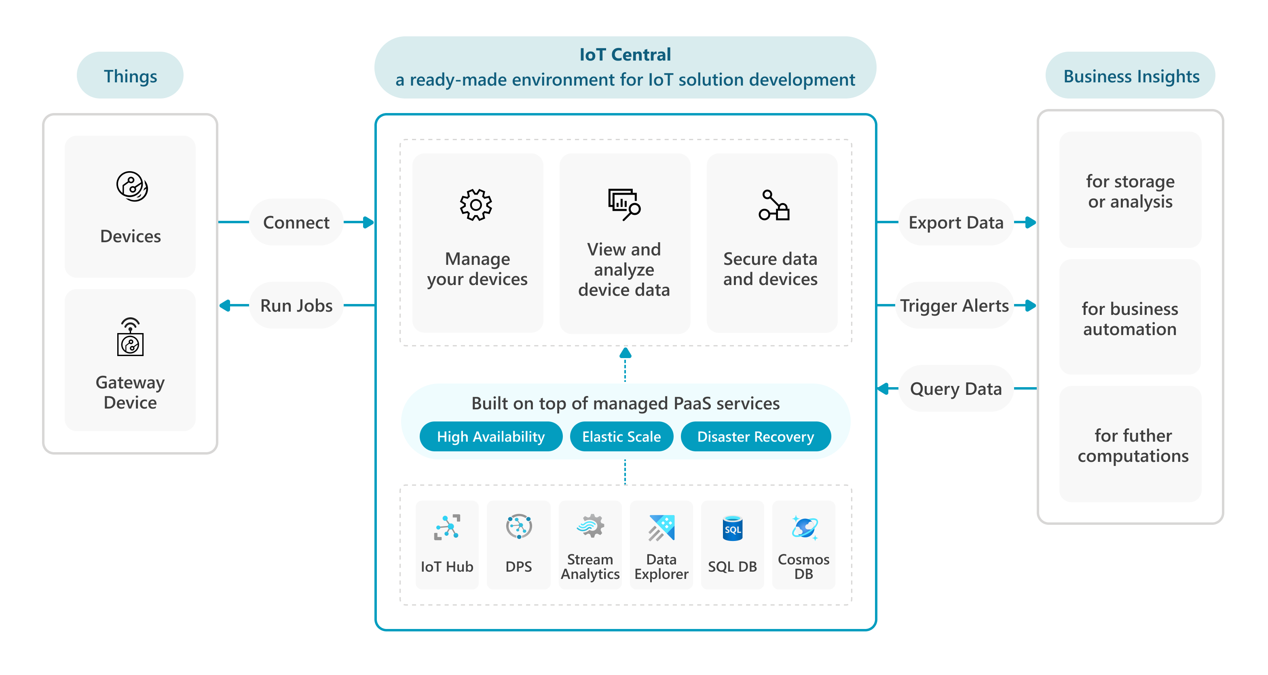
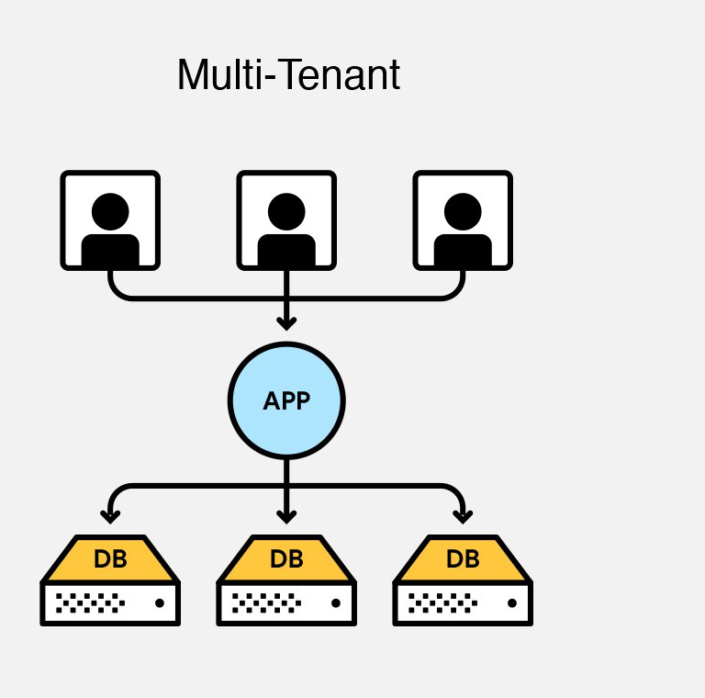
Helios Cloud
Azure IOT Central
Software-as-a-service
Azure IOT Hub
Device Templates
Firmware Update
White-label solution
Multi-tenancy support
Mobile Responsive
Data visualization
Jobs / Commands

Slide 23
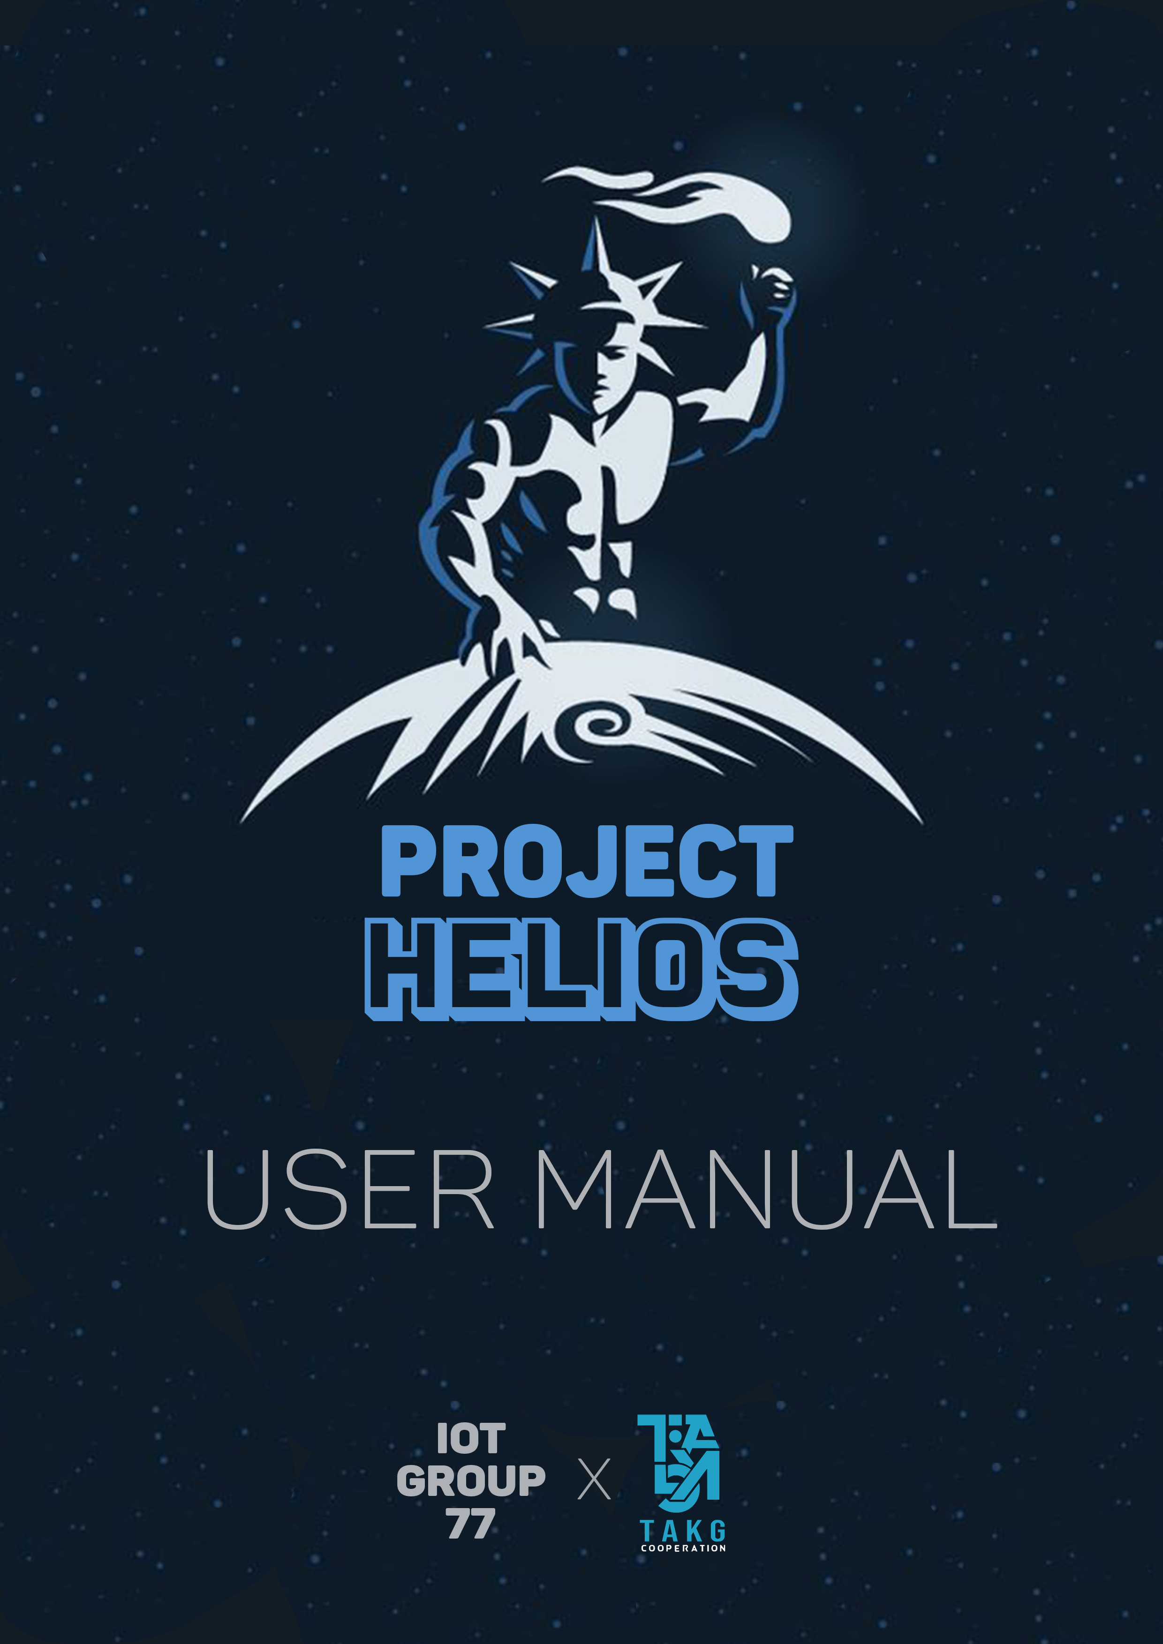
User Manual

Slide 24
THANK YOU!
Project Helios – Group 77

